Slide 1
Chapter 7
Sorting
We will sort arrays of elements under the assumption that:
The array contains only integers (This can be easily extended to any comparable)
The entire sort is done in memory
We will examine several algorithms based on their performance:
Several easy algorithms that sort in O(N²) such as the insertion sort.
The Shell sort which simple and perform in o(N²)
More complicated sorts that perform in O(nlogn)
We will show that any sort will require Ω(nlogn) comparisons

Slide 2
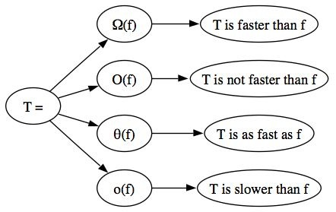
Recall Functions Order
Ω: T(n) = Ω(g(n))
T(n) grows at a rate faster than or equal to g(n)
Big O: T(n) = O(f(n))
T(n) grows at a rate not faster than f(n)
Θ: T(n) = Θ(h(n))
T(n) grows at the same rate ad h(n)
Little o: T(n) = o(p(n))
T(n) grows at a rate smaller than p(n)

Slide 3
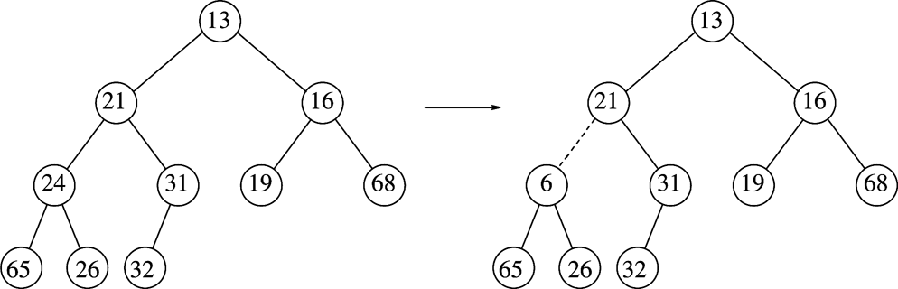
Recall The Binary Heap Properties
Heap-Order Property: The smallest element is the root and since any subtree needs to be a heap too then any node should be smaller than all of its descendants
The heap-order property can be formally stated as for any node X the key in the parent of X is less than or equal to the key in X
The tree on the left below is a heap but the one on the right is not (the parent of 6 is 21)

Slide 4

Binary Heap Using Max
Binary Heap Max (Prog 3) | 0 | 1 | 2 | 3 | 4 | 5 | 6 | 7 |  | Calculate Parent | Does it Violate rule
Input |  | 31 | 41 | 59 | 26 | 53 | 58 | 97
insert 31, 41 |  | 31 | 41 |  |  |  |  |  |  | 2/2 -> 1 | Y
Percolate Down |  | 41 | 31
Insert 59 |  | 41 | 31 | 59 |  |  |  |  |  | 3/2->1 | Y
Percolate Down |  | 59 | 31 | 41
Insert 26 |  | 59 | 31 | 41 | 26 |  |  |  |  | 4/2->2 | N
insert 53 |  | 59 | 31 | 41 | 26 | 53 |  |  |  | 5/2->2 | Y
Percolate Down |  | 59 | 53 | 41 | 26 | 31
Insert 58 |  | 59 | 53 | 41 | 26 | 31 | 58 |  |  | 6/2->3 | Y
Percolate Down/Recheck 58 |  | 59 | 53 | 58 | 26 | 31 | 41 |  |  | 3/2->1 | N
Insert 97 |  | 59 | 53 | 58 | 26 | 31 | 41 | 97 |  | 7/2->3 | Y
Percolate Down/Recheck 97 |  | 59 | 53 | 97 | 26 | 31 | 41 | 58 |  | 3/2->1 | Y
Recheck 58 |  | 97 | 53 | 59 | 26 | 31 | 41 | 58 |  | 7/2->3 | N

Slide 5
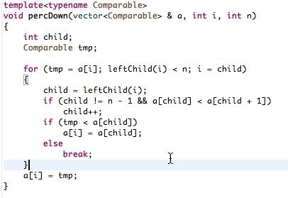
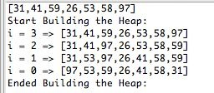
Building The Heap Using “PercDown”
 | 0 | 1 | 2 | 3 | 4 | 5 | 6 | size = 7 | i, size | tmp | child | child+1 |  | a[child) | i = child
Input | 31 | 41 | 59 | 26 | 53 | 58 | 97
i = 3 | 31 | 41 | 59 | 26 | 53 | 58 | 97 | 7/2 => 3 | 3,7 | 26 | 7
i = 2 | 31 | 41 | 59 | 26 | 53 | 58 | 97 |  | 2,7 | 59 | 5 | 6 | 58<97=> child=6 | 97 | 6
 |  |  | 97 |  |  |  | 59
 | 31 | 41 | 97 | 26 | 53 | 58 | 59
i = 1 | 31 | 41 | 97 | 26 | 53 | 58 | 59 |  | 1,7 | 41 | 3 | 4 | 26<53 =>child=4 | 53 | 4
 |  | 53 |  |  | 41
 | 31 | 53 | 97 | 26 | 41 | 58 | 59
i = 0 | 31 | 53 | 97 | 26 | 41 | 58 | 59 |  | 0,7 | 31 | 1 | 2 | 53<97=>child=2 | 97 | 2
 | 97
i = 2 |  |  |  |  |  |  |  |  |  |  | 5 | 6 | 58<59 =>child=6 | 59 | 6
 |  |  | 59 |  |  |  | 31
 | 97 | 53 | 59 | 26 | 41 | 58 | 31

Slide 6
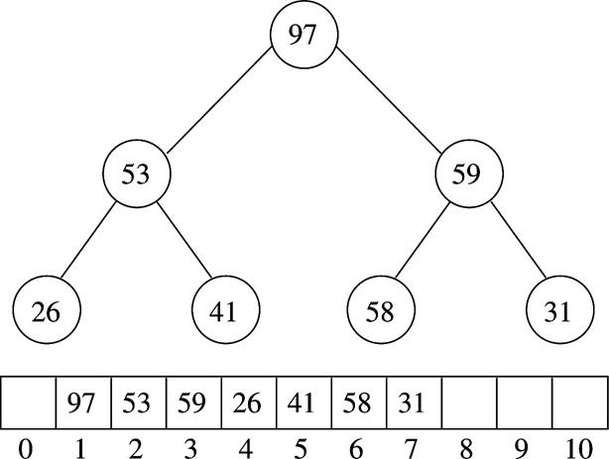
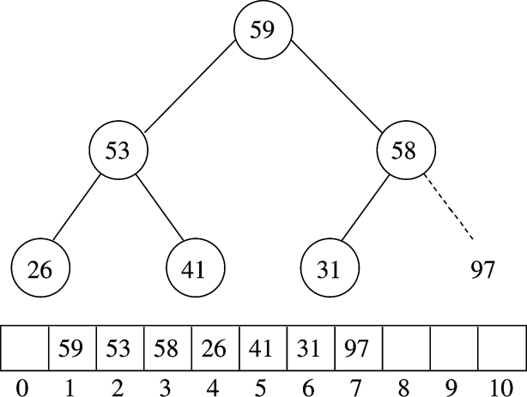
Heap Sort

Slide 7
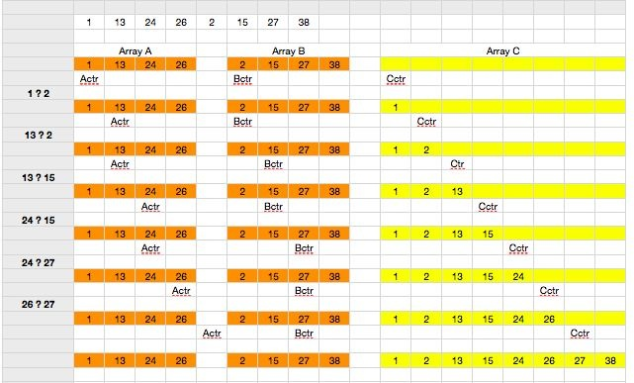
Merge Sort

Slide 8
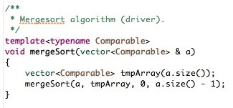
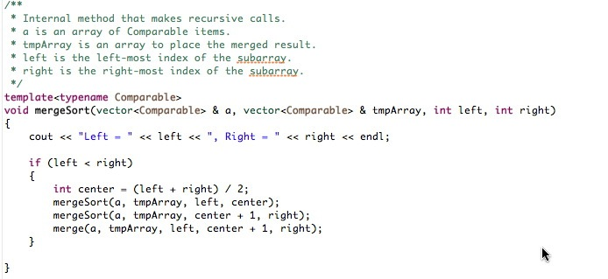
The Merge Sort Methods

Slide 9
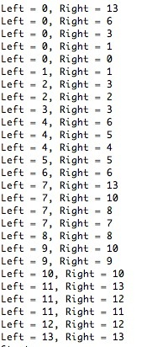

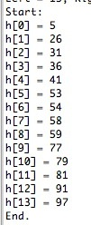
Merge Sort Recursive Nature

Slide 10
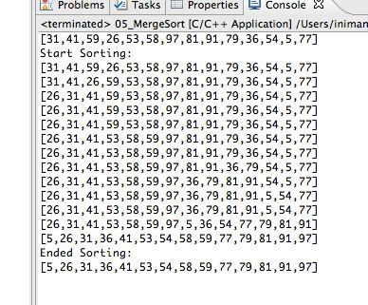
Condensed View of Merge Sort

Slide 11
Quick Sort
It uses the divide and conquer policy
It is recursive in nature
If n = number of elements of S is 0 or 1 then we are done
If n > 1 pick and element v of S , we call the pivot and divide S into S1 = {x∈ S - {v} | x ≤ v} and S2 = {x∈ S - {v} | x ≥ v}
Return quicksort(S1) followed by v followed by quicksort(S2)

Slide 12
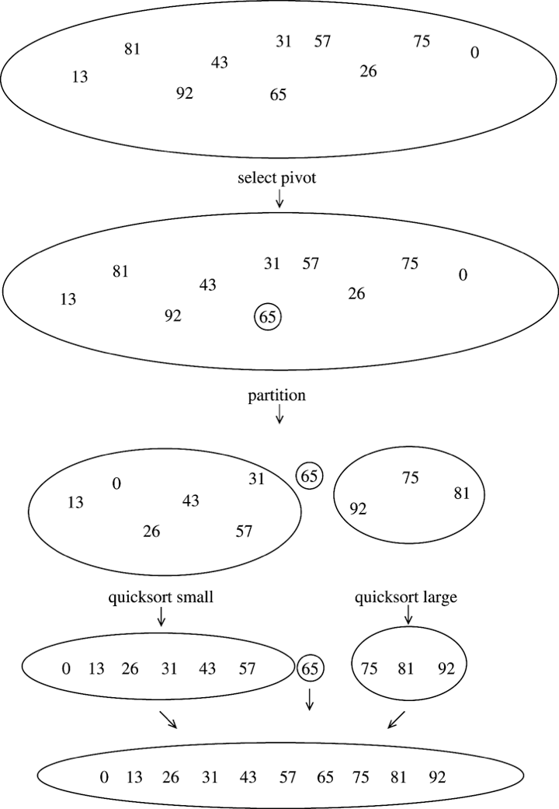
Quick Sort

Slide 13
Picking the Pivot
Pick s1, This is a bad idea,
Generate a random index i and pick si, better but not to great
Pick the median of S, The ⎡n/2⎤^{th} largest number,
If n is 7 we pick the 4th largest number
Pick three numbers at random and pick the median of these
Pick the median of {left most, center, right most}
consider S = {8, 1, 4, 9, 6, 3, 5, 2, 7, 0}, we pick the second largest of {8, 6, 0} which is 6
Partitioning Strategy: Move all smaller elements to the left and larger elements to the right.

Slide 14
Swapping Strategy
 | 8 | 1 | 4 | 9 | 6 | 3 | 5 | 2 | 7 | 0
Swap Pivot with last
 |  |  |  |  | 0 |  |  |  |  | 6
Move th pivot | 8 | 1 | 4 | 9 | 0 | 3 | 5 | 2 | 7 | 6
 | ↑ |  |  |  |  |  |  |  | ↑
Start i and J | i |  |  |  |  |  |  |  | j
i -> skip small
j <- skip large
swap until they cross
 | 8 | 1 | 4 | 9 | 0 | 3 | 5 | 2 | 7 | 6
i does not move | ↑
j skips 7 moves to 2 | i
 |  |  |  |  |  |  |  | ↑
Swap 8 and 2 |  |  |  |  |  |  |  | j
 | 2 | 1 | 4 | 9 | 0 | 3 | 5 | 8 | 7 | 6
i skips 2,1,4 | ↑ |  |  |  |  |  |  | ↑
j skips 8 | i |  |  |  |  |  |  | j
 |  |  |  | ↑ |  |  | ↑
 |  |  |  | i |  |  | j
 | 2 | 1 | 4 | 5 | 0 | 3 | 9 | 8 | 7 | 6
i skips 5, 0, 3 |  |  |  | ↑ |  |  | ↑
j skips 9 |  |  |  | i |  |  | j
 |  |  |  |  |  | ↑ | ↑
No swap |  |  |  |  |  | j | i
Switch ith with pivot | 2 | 1 | 4 | 5 | 0 | 3 | 6 | 8 | 7 | 9
i moves to the right as long it is at or skipping over a smaller element than the pivot (stops at larger)
j moves to the left as long as it is at or skipping over a larger element than the pivot (Stops at smaller)

